Slide 1

Capstone Project
Smart Library Manager
Presented by:
Abhigna K Prasad(CGI08)
Gagana H(CGI08)

Slide 2

Library Management System (Web-Based) Tech Stack: Python (backend), Django REST Framework (APIs), React.js (frontend), SQLite (database).
Core Operations:
a.Add/Delete Books
b.Borrow/Return Books
c. Register/Manage Members
Goal: Build a modern, efficient, and automated library system with seamless integration of Django and React.
Introduction

Slide 3

Problem Statement
Manual management is slow and error-prone
Inefficient tracking of books and transactions
Difficulty maintaining accurate, updated records
Lack of user-friendly interfaces in existing systems
Need for a modern, web-based automated solution

Slide 4
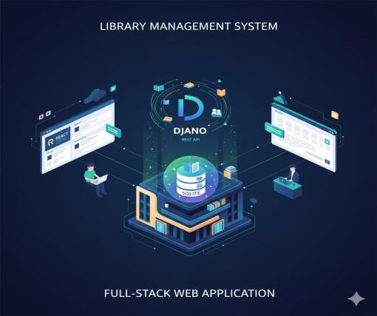
Project Overview
A full-stack web application for managing library operations.
Frontend: React handles forms, lists, and UI.
Backend: Django REST API validates requests and processes logic.
Database: SQLite stores all books, members, and transactions.
Python backend: Implements core logic using object-oriented principles and file handling

Slide 5

Software Requirements
Programming Languages
Python 3.10+ , JavaScript
Backend
Django 5.3,Django REST Framework
django-cors-headers
Frontend
React.js , Axios
Database
SQLite
Development Tools
Node.js 18+ and npm
Code Editor
Testing & Deployment
Django Admin for backend testing
Browserfor frontend testing
Localhost server

Slide 6
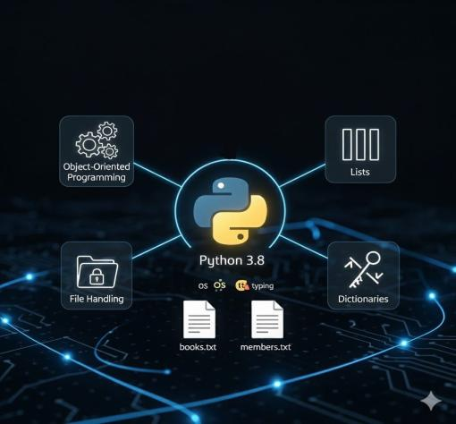
Software Requirements-Python bakend
Software used: Python 3.8
Knowledge Required:
Object-Oriented Programming
File handling
Dictionaries and Lists in Python?
Files Used:
books.txt : store book data?
members.txt : store member data
Modules Used:
os : check file existence?
typing : add type annotations

Slide 7
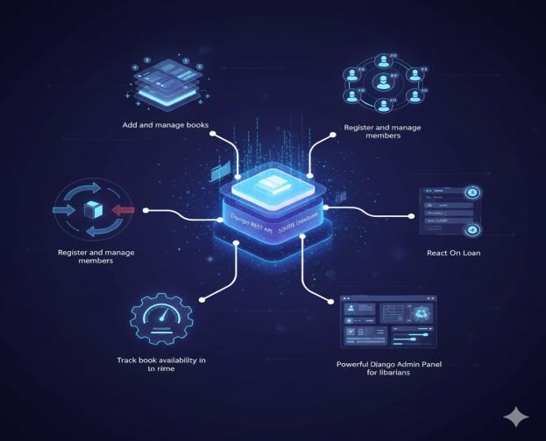
Key Features

Slide 8

Key Features
Add and manage books with details
(ID, Title, Author, ISBN).
Track book availability in real time.Automate book and member management with CRUD functionality.
Register and manage members
with unique IDs.
Powerful Django Admin Panel for librarians to manage everything.
Borrow and return book workflows with validations.
Modern, responsive UI built with React.

Slide 9
Objectives
Build a Library Management System
using Django for the backend and React.js
for the frontend.
Create secure APIs to handle books, members, and transactions.
Write clean and maintainable code, applying object-oriented principles and best practices.
Use SQLite to safely store and manage all
library data, ensuring accuracy and persistence.
Provide an responsive web interface that is simple for librarians and members to use.
Make the system scalable for
adding new features in the future.

Slide 10
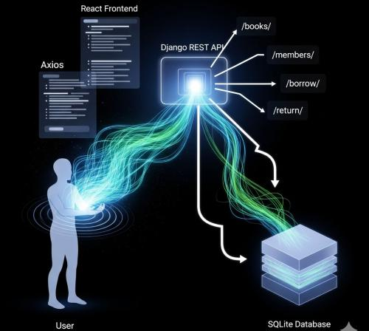
Design Flow
React (Frontend) → Displays forms & lists, makes API calls using Axios.
Django REST API (Backend) → Exposes /api/books/, /api/members/, /borrow/, /return/ endpoints.
SQLite Database → Stores book/member records and borrow-return relations.
Flow: User → React → Axios → Django API → SQLite → Response → React UI.

Slide 11
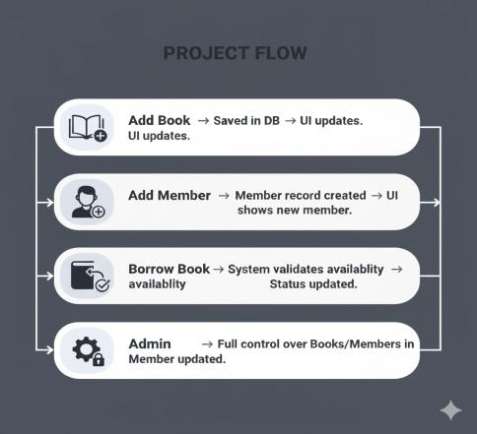
Project Flow
Add Book ➝ Saved in DB ➝ UI updates.
Add Member ➝ Member record created
➝ UI shows new member.
Borrow Book ➝ System validates availability ➝ Status updated.
Return Book ➝ Book marked available
➝ Member updated.
Admin ➝ Full control over Books/Members in /admin/.

Slide 12
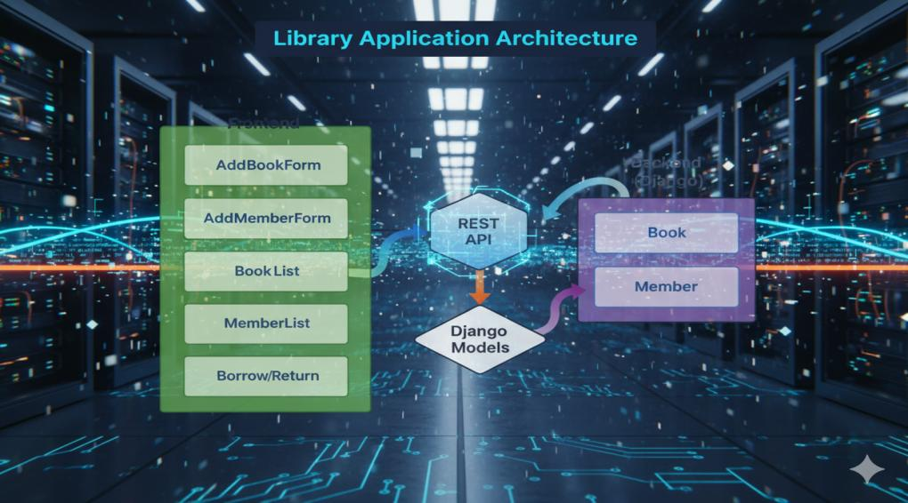

Slide 13
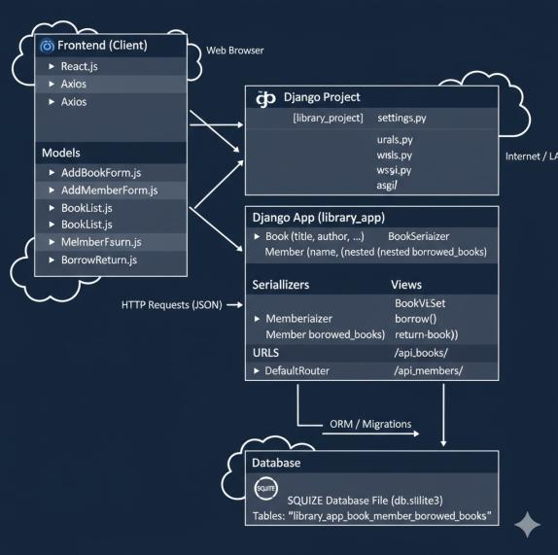
Architecture Diagram

Slide 14


CORE MODELS
CLASS 1: Book
1. Represents a book in the library.
2. Attributes:
a. book_id : Unique book identifier (e.g., B001)
b. title : Title of the book
c. author : Author’s name
d. isbn : Unique ISBN number
available : Availability status (True = Available, False = Issued)
3. __str__: Returns book details with status.
Class 2: Member
Represents a library member.
Attributes:
a.member_id :Unique member identifier (e.g., M001)
b.name : Member’s full name
c.borrowed_books : Many-to-Many relation with Book
3. __str__: Returns member ID and name

Slide 15


ADMIN CLASSES
CLASS 3: BookAdmin (Django Admin)
Purpose: Manages Book model in Django Admin.
Features:
a. list_display : Shows book_id, title, author, isbn, available
b. search_fields : Search by ID, title, author, ISBN
3. list_filter : Filter by availability
Class 4: MemberAdmin (Django Admin)
Purpose: Represents a library member.
Attributes:
a.member_id : Unique member identifier (e.g., M001)
b.name : Member’s full name
c.borrowed_books : Many-to-Many relation with Book
3. __str__: Returns member ID and name

Slide 16
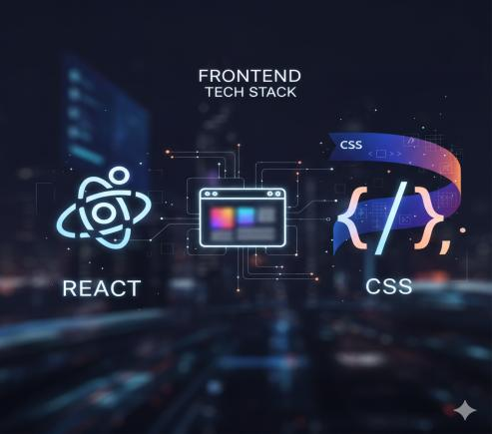
Tech Stack (Frontend)
ReactJS: Modern, component-based UI library.
Axios: Handles API requests between React and Django.
CSS : Used for styling UI elements.
Provides an interactive, fast, and user-friendly interface.

Slide 17

Tech Stack (Database)
SQLite: Lightweight, serverless, and bundled with Django.
Easy to configure and perfect for small-to-medium apps.
Stores:
a. Book Records (Available/Issued).
b. Member Records.
4. Relationships (Borrowed books per member).

Slide 18
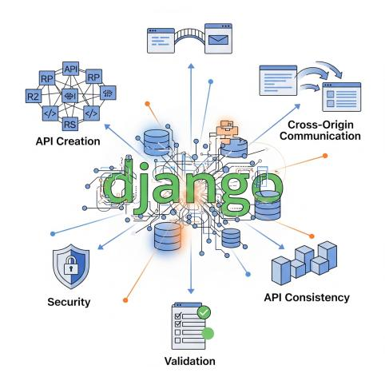
Django 5.3: Powerful Python framework for web apps.
Django REST Framework: Simplifies API creation.
Django CORS Headers: Enables communication between React and Django (cross-origin requests).
Ensures security, validation, and API consistency.
Tech Stack (Backend)

Slide 19

Backend
Django+SQLite+DRF

Slide 20

Backend Setup
Create virtual environment using python -m venv .venv.
Install packages: Django, DRF, django-cors-headers.
Start project: django-admin startproject library_project.
Start app: python manage.py startapp library_app.
Configure settings.py for installed apps, middleware, DB.

Slide 21
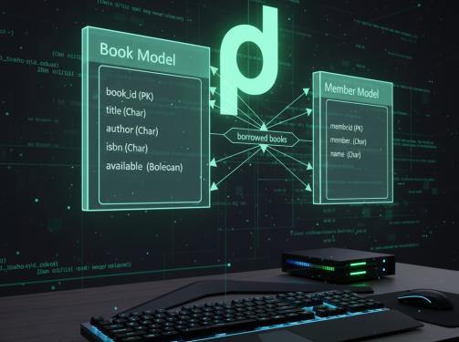
Backend Models
Book Model: Each book has a unique book_id, a title, an author, an isbn, and an available status (True/False).
Member Model: Each member has a unique member_id, a name, and a field for borrowed_books.
Relationship: A many-to-many relationship connects the Member and Book models, allowing the system to accurately track which books each member has borrowed.

Slide 22
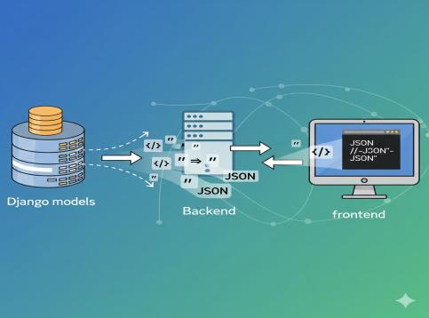
Backend Serializers
Purpose: Convert Django models → JSON (and vice versa).
BookSerializer: Handles book fields.
MemberSerializer: Includes borrowed_books and borrowed_books_detail.
Ensures clean data exchange between frontend & backend.

Slide 23

Backend Views
1. BookViewSet:
a. CRUD operations for books
(Add, Edit, Delete, List).
2. MemberViewSet:
a. CRUD for members.
3. Custom actions: borrow() and return_book().
4. Business logic handled at API layer for consistency.

Slide 24
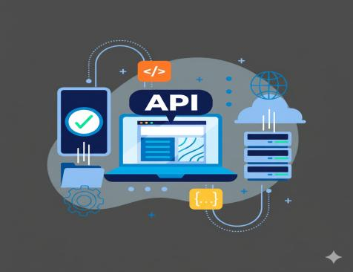

Backend API Routes
/api/books/ : List, Add, Delete, Update books.
/api/members/ : Manage members.
/api/members/{id}/borrow/ : Borrow book.
/api/members/{id}/return/ : Return book.
/admin/ : Django admin panel.

Slide 25
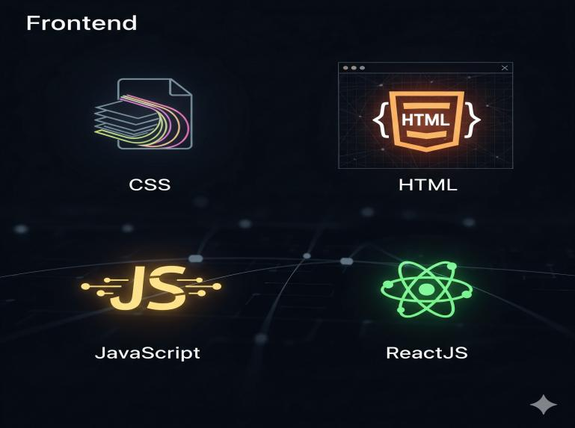
FRONTEND

Slide 26

Frontend Setup
Create React App: npx create-react-app frontend.
2.Install Axios: npm install axios.
3. Folder structure:
src/components/ → Forms & Lists.
api.js → Axios config.
App.js → Main entry point.

Slide 27
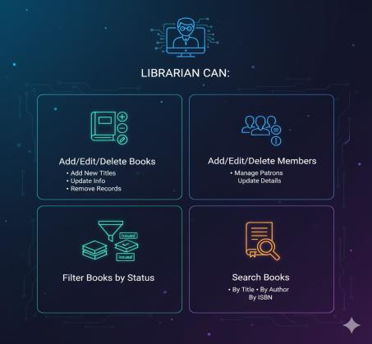
Admin Panel
Librarian can:
a. Add/Edit/Delete Books.
b. Add/Edit/Delete Members.
c. Filter books by status- (Available/Issued).
d. Search by title, author, or ISBN.

Slide 28



Borrow Book Logic
API: /api/members/{id}/borrow/.
Steps:
Validate book exists.
Check if book is available.
Assign book to member.
Mark book as issued (available=False).
Return updated JSON.

Slide 29



Return Book Logic
API: /api/members/{id}/return/.
Steps:
Validate member borrowed the book.
Remove book from member’s borrowed list.
Mark book as available.
Return updated JSON.

Slide 30


Addbookform. js
Add new books to the system
Provides a form for adding new books with details like ID, title, author, and ISBN.
Submits data via Axios to the Django API and updates the UI after success.
.
addmemberform.js
Register new members.
Uses controlled forms with state (useState).
Axios POST request updates backend & UI.

Slide 31



React Components
BookList.js:
a. Displays all books with availability status.
b. Allows deletion of books.
MemberList.js:
a. Displays members and their borrowed books.
b. Allows deletion of members.
BorrowReturn.js:
a. Dropdowns to select member + book.
b. Borrow and Return buttons.
c. Success/error messages displayed.
d. Ensures smooth workflow for users.

Slide 32
Add/Remove Workflow
Add
Remove
User clicks Delete button for a book in React (BookList component).
Axios sends DELETE /api/books/{id}/ request.
Django REST Framework processes the request and deletes the book record from SQLite.
JSON response returned.
React updates UI with “Book added”.
User fills Add Book form in React.
Axios sends POST /api/books/.
Django validates via serializer & saves in SQLite.
JSON response returned.
React updates UI with “Book added”.

Slide 33
Borrow/Return Workflow
Borrow
Return
Select member + book.
API removes book from member & marks available.
UI updates instantly.
a. Select member + book.
b. API validates & marks book issued.
c. UI updates with new status.

Slide 34
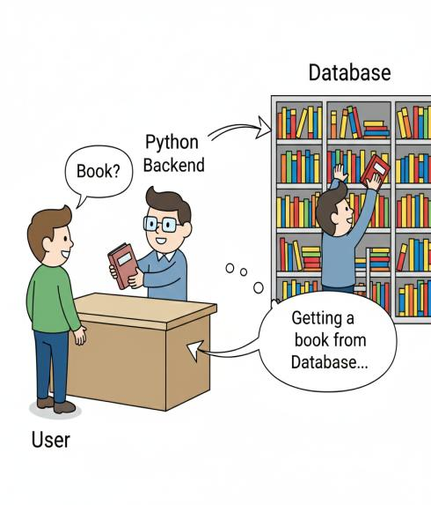
Python
Backend

Slide 35
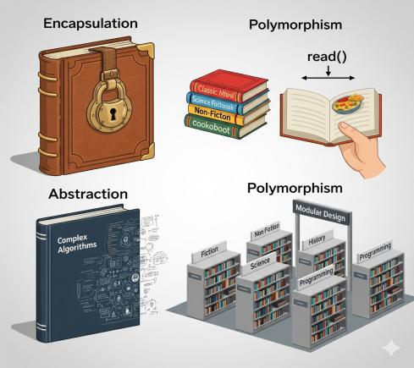
Concepts Used
Python OOP Principles:
Encapsulation
Abstraction
Polymorphism
Modular design : Separate Book, Member,
and Library classes.
3.File Handling:
Persistent storage of books and members.
load() and save() methods handle reading/writing.

Slide 36
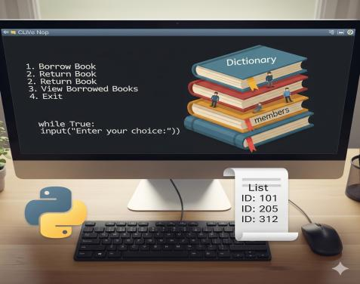
Concepts Used
1.Data Structures:
a. Dict :Store books and members using IDs as keys.
b. List : Track borrowed book IDs.
2. CLI Interaction:
Menu-driven input loop (while True:) using input().

Slide 37
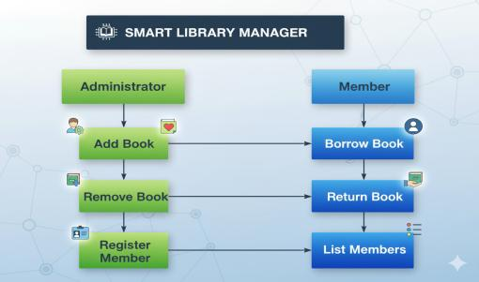
Library System Manager Workflow
Administrator Tasks: Manages books (add/remove) and registers members.
Member Actions: Borrows and returns books, and can view a list of members.
Book Flow: Books are added/removed by the administrator and borrowed/returned by members.
User Registration: Administrators register members for library access.

Slide 38
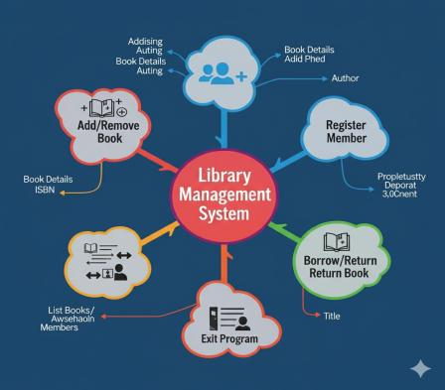
CLI Menu (run_cli)
A. Provides interactive user interface:
Add / Remove Book
Register Member
Borrow / Return Book
List Books / Members
Exit Program
B. Uses while True loop with input validation.

Slide 39





Advantages
Automated system eliminates manual errors.
Real-time updates for book availability.
Scalable architecture suitable for growing libraries.
Cross-platform accessibility through a responsive React interface.
Time-efficient workflows for book and member management.

Slide 40
Conclusion
This comprehensive Smart Library Management System integrates Python, Django, React, and SQLite to create a reliable and user-friendly solution. The backend, built with Python's object-oriented design and file handling, ensures the system is well-organized and easy to maintain. A smooth and responsive interface is provided by the seamless integration of React and Django, while SQLite guarantees efficient data storage and quick access. Ultimately, the system improves accessibility and simplifies daily tasks for librarians, members, and administrators, and its scalable and flexible design allows for future enhancements like role-based access, advanced search, and analytics.

Slide 41
THANK YOU

